Slide 1
Unit 201: Health and safety in building services engineering
Personal protective equipment

Slide 2
Personal protective equipment
PPE is designed to protect against workplace hazards. Health and Safety at Work Regulations require employers to provide:
protective clothing for working outdoors
eye protection from dust, sparks or flying objects
respirators to protect from dust and fumes
ear defenders where noise levels are above 80dB
protective clothing when exposed to hazardous substances such as lead
shelter for use during bad weather
storage equipment for PPE.

Slide 3
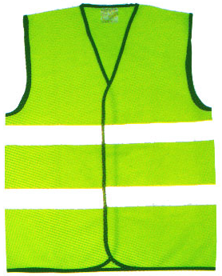
Personal protective equipment
High-visibility clothing
High-visibility clothing is worn by those who need to be seen during poor lighting or weather conditions, or when working in environments where there is a lot of moving machinery.
Most construction sites require all persons to wear high-visibility clothing whilst on site.

Slide 4
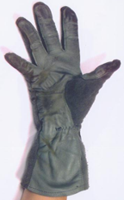
Personal protective equipment
Hand protection
A wide assortment of gloves, hand pads, sleeves and wristlets can be used where there are hazards present that can cause arm and hand injuries, such as burns, electrical shock or absorption of chemicals.
Wearing the wrong sort of glove or defective gloves is a major problem.

Slide 5
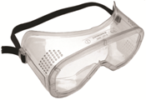
Personal protective equipment
Eye protection
Forms of eye protection include goggles, visors, shields and face screens.
Eye protection is required by law when working in hazardous areas and should be worn to protect from possible injuries caused by corrosive substances, welding/soldering, and using hammers, chisels and power drills.

Slide 6

Personal protective equipment
Head protection
Helmets protect from falling objects and the risk of hitting your head on objects such as scaffolding.
Head protection is also required when working in confined spaces, as the likelihood of banging your head on the structure where you are working is greatly increased.

Slide 7
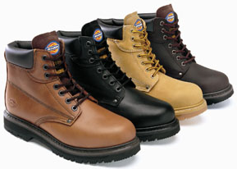
Personal protective equipment
Foot protection
These protect against heavy objects falling on your feet, and boots can also provide ankle and lower leg protection.
Boots, such as wellington style boots, can also provide protection against chemicals and other unpleasant substances.

Slide 8
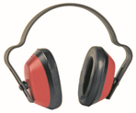
Personal protective equipment
Hearing protection
Noise is an invisible enemy. Hearing protection, such as ear defenders, is required if noise levels are above 80 decibels.

Slide 9
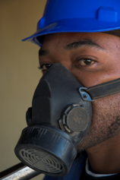
Personal protective equipment
Respiratory protection
Cutting and grinding materials, such as wood and cement, create a large amount of dust and fumes. Moreover, materials such as solvents can also cause respiratory problems.
Respirators and dust masks protect from airborne particles which can cause serious lung damage and breathing problems.

Slide 10
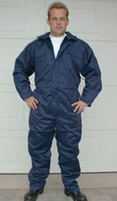
Personal protective equipment
Protective clothing
Overalls are not worn just to keep you clean but also to protect from injuries such as burns. Boiler suits are the safest option, as they provide full body protection.
High-visibility clothing also needs to be worn when working in hazardous areas, such as next to a busy road.

Slide 11
Unit 201: Health and safety in building services engineering
The End

